Slide 1

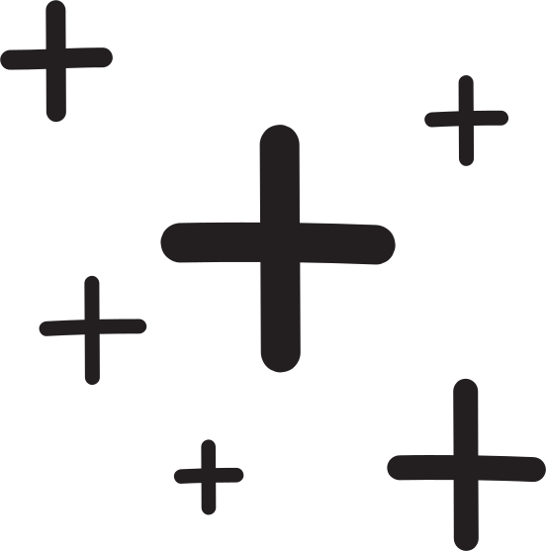





TEXT TO IMAGE GENERATION USING STABLE DIFFUSION
GROUP ACITVITY

Slide 2
Meet The Team
Shubham Mahind - 21BAI10407
Siddhesh Darne - 21BAI10401
Shaunak Abhonkar - 21BAI10348
Prathamesh Gole - 21BAI10346
Arpan Biswas - 21BAI10352

Slide 3

Introduction
In this presentation, we will explore the potential of Stable Diffusion in generating realistic images from text. We will discuss the applications, challenges, and future prospects of this groundbreaking technology.

Slide 4

Understanding Stable Diffusion
Stable Diffusion is a cutting-edge machine learning technique that leverages the power of probabilistic models to generate high-quality images from textual prompts. It employs a diffusion process to iteratively refine the generated images

Slide 5
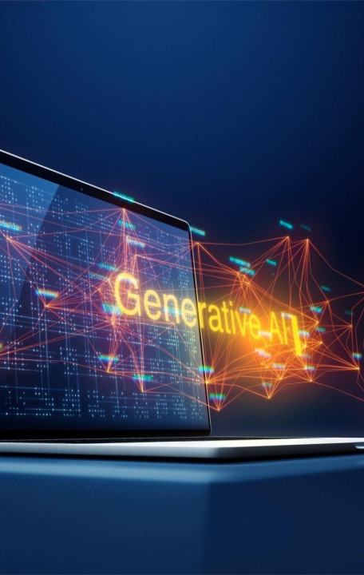
Applications in Creative Industries
Stable Diffusion has immense potential in artistic creation, advertising, and graphic design. It enables the generation of custom visuals based on textual descriptions, revolutionizing the creative process.

Slide 6
Advantages of Stable Diffusion
Flexibility and Diversity: Unlike traditional text-to-image generation methods that may struggle with diversity and adaptability, Stable Diffusion offers unparalleled flexibility in generating diverse images from varied textual prompts.
High-Quality Image Generation: Stable Diffusion excels in producing high-quality images that exhibit realistic textures, colors, and details.
Conceptual Consistency: One of the key strengths of Stable Diffusion lies in its ability to maintain conceptual consistency between textual descriptions and generated images.
Control over Style and Content: Stable Diffusion provides users with fine-grained control over both the style and content of generated images.

Slide 7
How does Stable Diffusion Work?
Text Prompt Integration: At each time step of the diffusion process, the model integrates information from a provided text prompt. This text prompt guides the generation process by influencing the evolution of the image's content and style.
Diffusion Process: Stable Diffusion employs a unique diffusion process as the foundation for image generation. This process involves iteratively applying controlled noise to an initial image over multiple time steps.
Adaptive Generation: One of the key strengths of Stable Diffusion lies in its adaptive generation capabilities. The model dynamically adjusts its generation process based on the complexity and specificity of the text prompt.

Slide 8
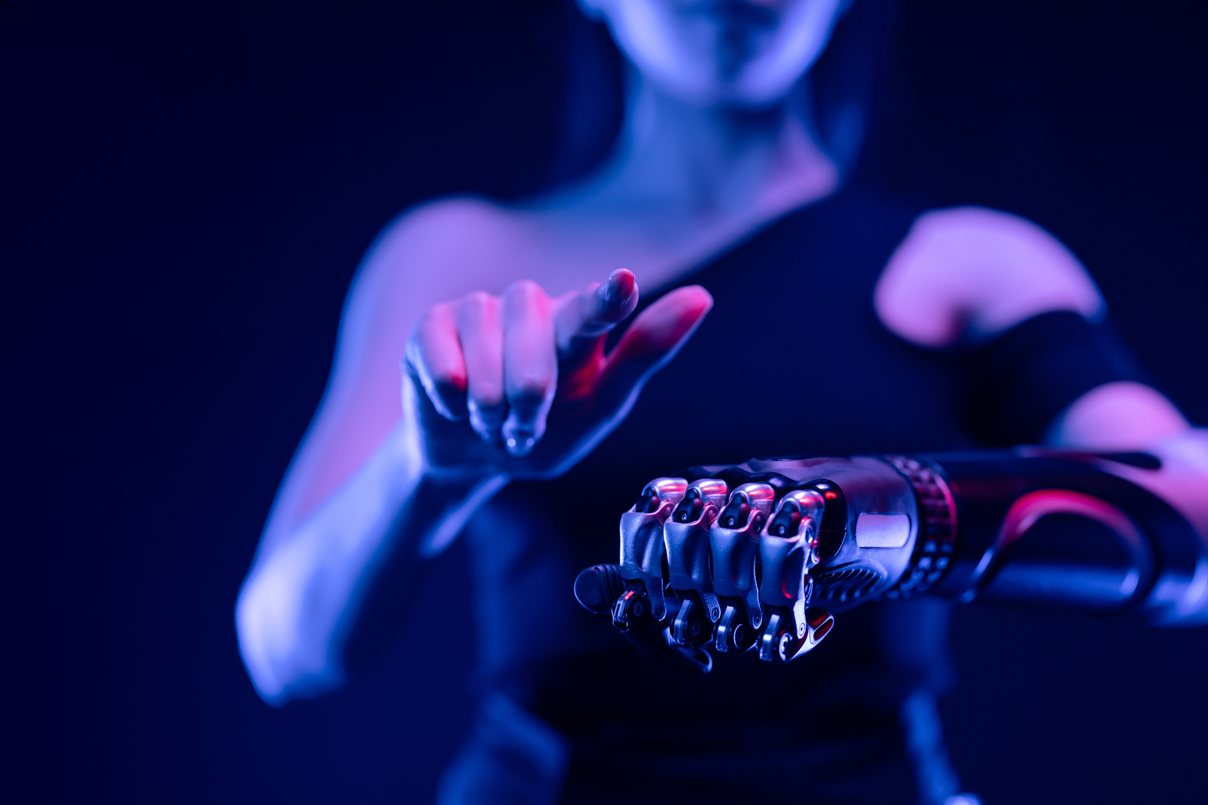
Challenges and Limitations
Despite its promise, Stable Diffusion faces challenges such as bias amplification, complex training requirements, and ethical considerations. Overcoming these hurdles is crucial for widespread adoption.

Slide 9

Results and Achievements
The future of Stable Diffusion holds exciting possibilities, including advancements in multimodal generation, interactive interfaces, and real-time image synthesis. These innovations will reshape the way we interact with visual content

Slide 10
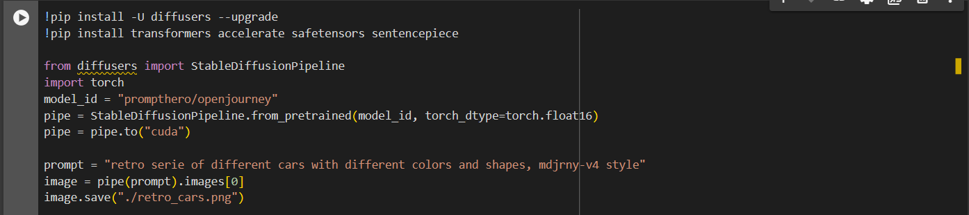
Code :-

Slide 11
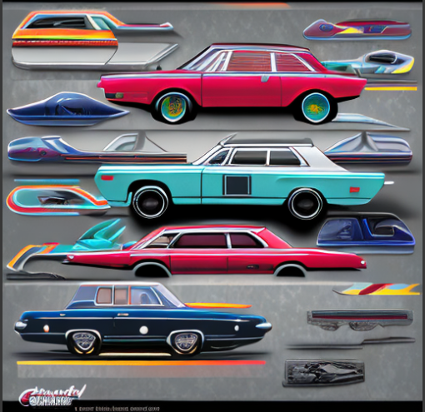
Output :-

Slide 12
Thank
You

